Slide 1
HR Analysis
JANUARY 2025
Name: Foo Chit Long Darren

Slide 2
01
02
EXPLORATORY ANALYSIS
RECRUITMENT SOURCE
TABLE OF CONTENTS
03
04
MANAGER PERFORMANCE
PAY RATE FACTORS
05
06
DASHBOARD
EMPLOYEEE RETENTION

Slide 3
01
EXPLORATORY ANALYSIS
www.slidesgo.com
HR Analysis
-HUMAN RESOURCES DEVELOPMENT-
-HUMAN RESOURCES DEVELOPMENT-
Company background, demographic and distribution

Slide 4
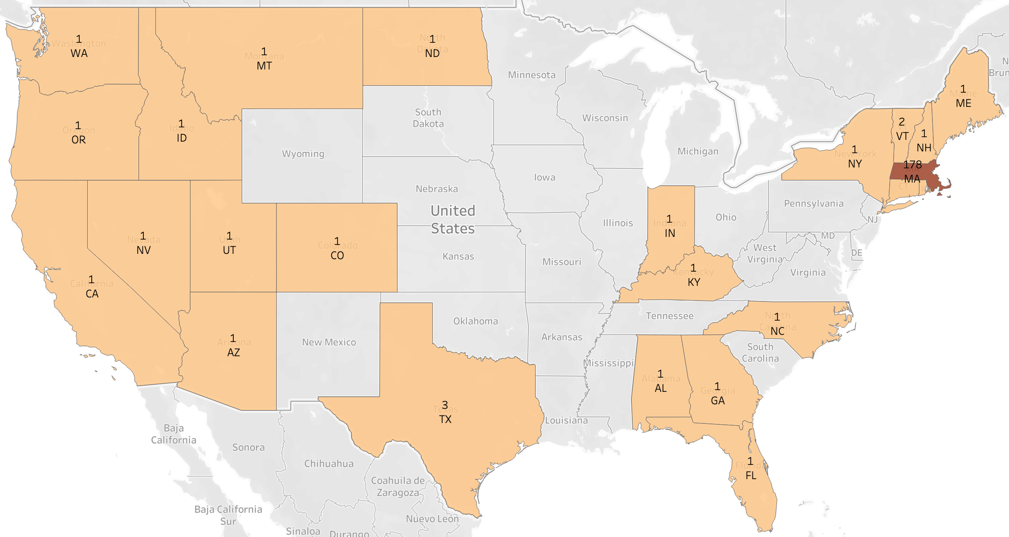
COMPANY
Areas of Operations
The main operations of ABC company is in Massachusetts, with a wide coverage around the United States from Maines to Washington. (Figure 1) Avenues to explore are common recruitment seasons across the year in Massachusetts and common employee turnover time in the state to improve retention strategies.
Retention
ABC Company has retained 2/3 of its employee count since their start. Its retention rate is slightly lower meaning that there are avenues to tap into to reduce turnover.
BACKGROUND
HR Analysis
Figure 1: Heat Map of Employee Count
RETENTION RATE
67.3%

Slide 5
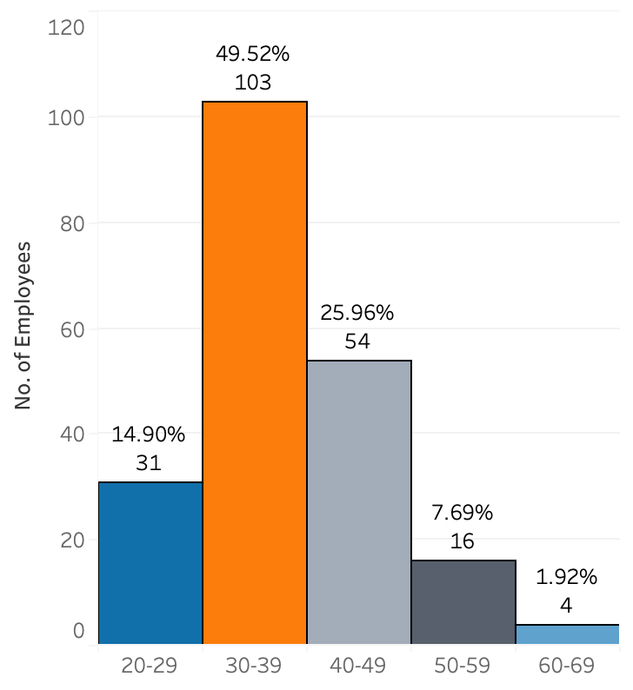
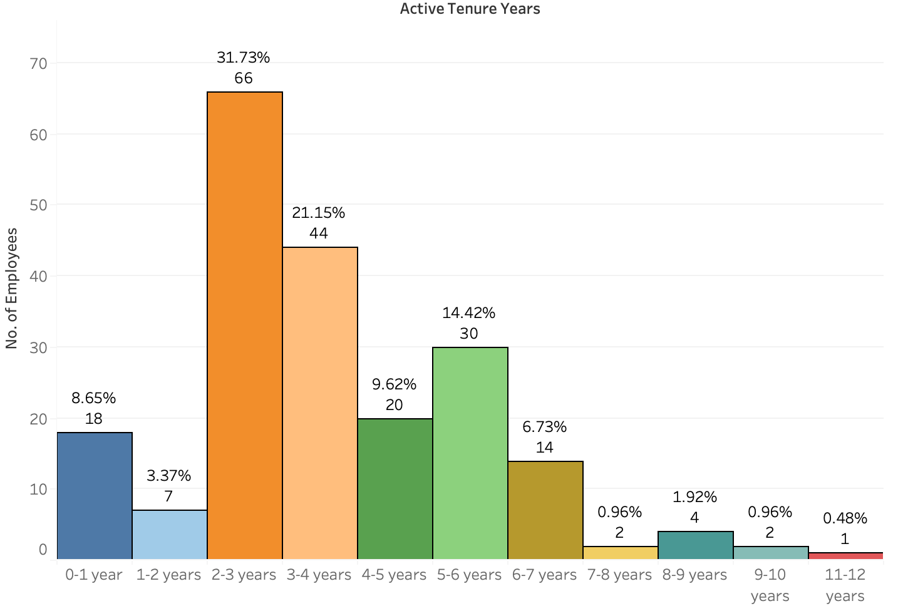
EMPLOYEE
Employee Age Distribution
The current workforce in ABC Company mainly comprises of 30s to 50s, about 75%. (Figure 2) The minority age group in the company comprises of seniors aged 50s to 70s meaning that the company would face lesser issues with workforce planning and succession planning. However, the company should pay attention to its majority of its distribution of 30s– 40s, as they often seek opportunities for career progression.
Gender Distribution
ABC company’s workforce comprises more female than male. Workforce planning in terms of maternity leave could be looked into.
Tenure Distribution
Half of the employees in ABC Company has worked for 2-4 years. (Figure 3) With very few employees in the 0-2 year tenure group which could hint that the company may not be hiring as many employees or highlight issues regarding early turnover.
DEMOGRAPHIC
Figure 2
Female
57%
Male
43%
HR Analysis
Figure 3: Tenure of Employees
*Current employees only

Slide 6
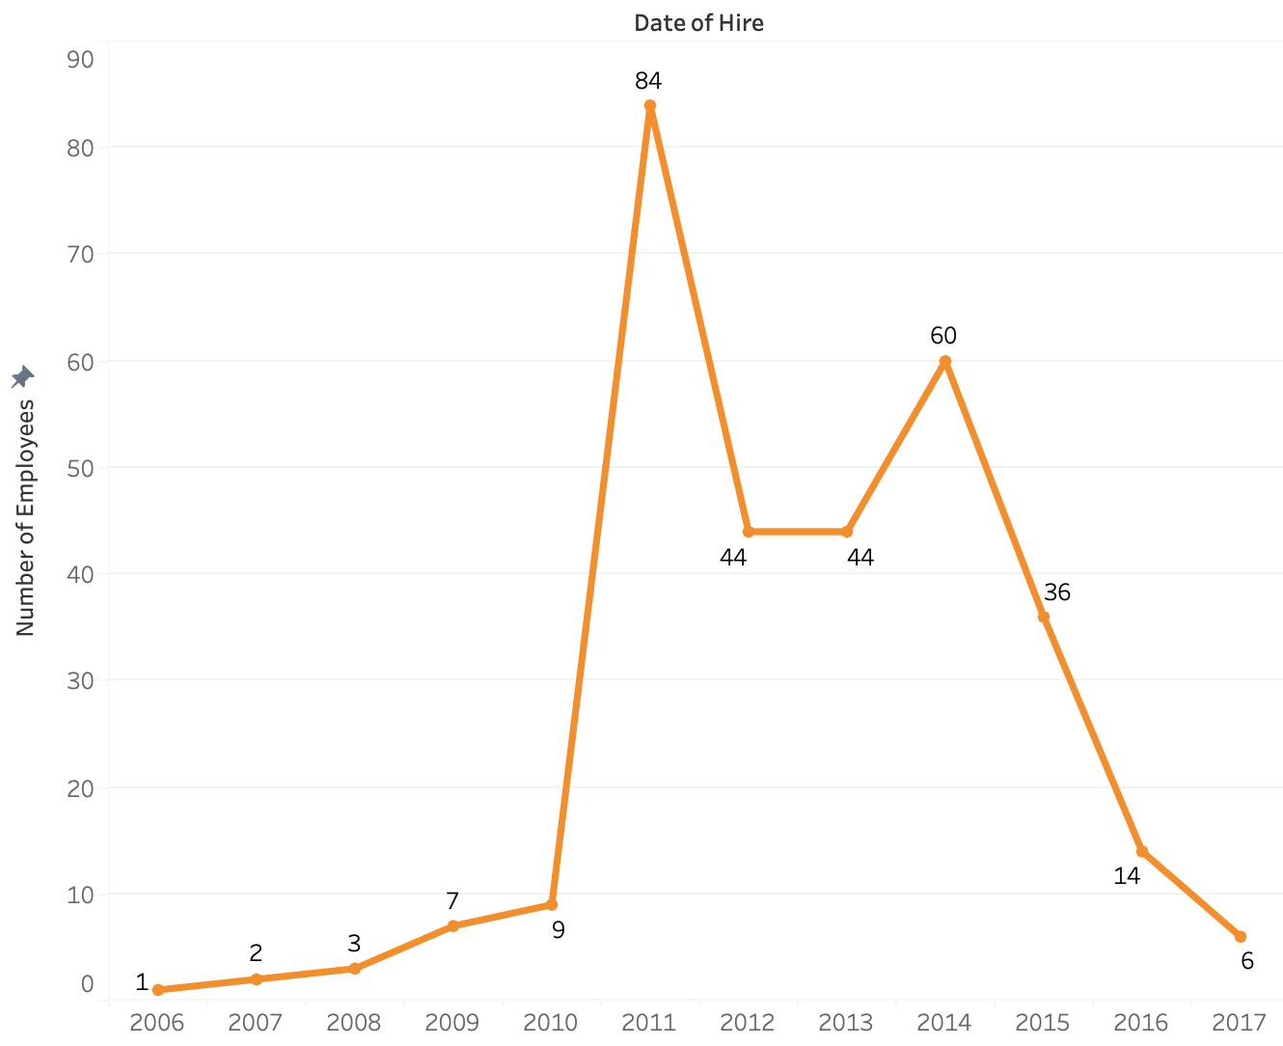
TREND
RATE OF EXPANSION
Years with Rapid Expansion
The company experienced significant hiring in certain years, indicating rapid expansion phases. Particularly notable are:
2011: A substantial increase with 84 hires.
2012 & 2013: Consistently high hiring with 44 hires each year.
2014: Another peak with 60 hires.
Other Years
Before 2011, the hiring numbers were relatively low, suggesting a smaller scale of operations or a stable workforce with less turnover.
After 2014, slower expansion rate and could indicate that hiring goal was to fill in gaps identified in teams.
Current Trend 2017
Company isn’t expanding as quickly as compared to possible 2011-2014. With the expansion of the BI team, the company could be looking at finding newer avenues in their market to tap into and expand further.
HR Analysis

Slide 7
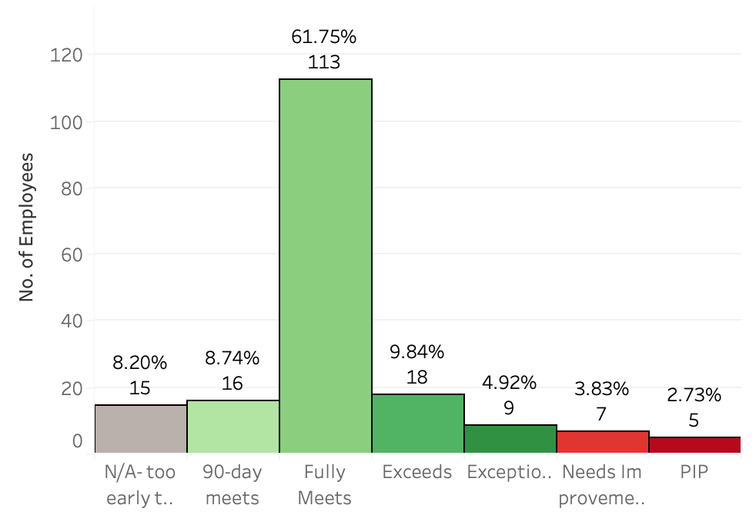
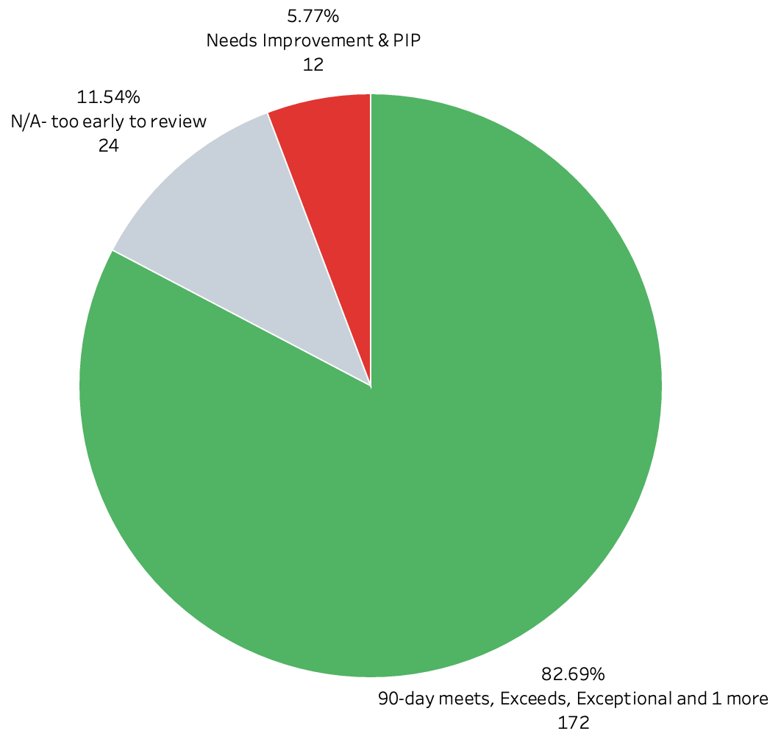
EMPLOYEE
Employee Performance Distribution
A significant proportion of ABC Company's workforce, approximately 80% (Figure 5), demonstrates commendable performance levels, ranging from meeting expectations within 90 days to achieving exceptional results. With a good segregation of performance for the upper echelon, exceeds with close to 10% and exception for top 5%.
In terms of employees with poor performance, there are only about 6%. While this distribution generally reflects a positive trend of strong employee performance, it also raises the possibility of bias within the evaluation system.
PERFORMANCE
Figure 4: Employee Performance
HR Analysis
Figure 5: Grouped Employee Performance
*Current employees only
Notes:
Didn’t suggest a recommendation for this as, there were other avenues that gave greater impact and should be prioritized first.

Slide 8
02
RECRUITMENT SOURCE
www.slidesgo.com
HR Analysis
-HUMAN RESOURCES DEVELOPMENT-
-HUMAN RESOURCES DEVELOPMENT-
What are the best recruitment sources for this company to use?

Slide 9
WHAT CLASSIFIES AS BEST?
COST EFFECTIVE | PERFORMANCE OF HIRES
Hiring the most employees with the least cost Enables the company to allocate resources wisely, ensuring that funds are not spent on expensive recruitment channels when more affordable avenues provide similar or better results | Source should provide a good proportion of good performance employees Hiring many new hires at low cost is not advantageous if it does not offer hires with high quality performance. Instead, it will bring in extra cost by restarting the hiring pipeline
What?
What?
Why?
Why?
*Recruitment source must have hired > 5 employees
Notes:
I was contemplating on using retention as a score, but felt that employees could still leave despite having a good performance.

Slide 10
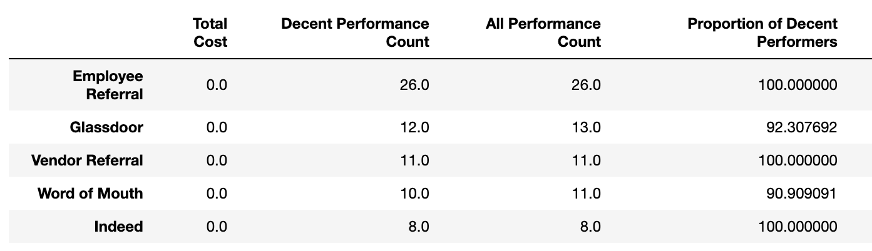
BEST “NO COST” SOURCE
EMPLOYEE REFERRAL
*Excludes employees who have “N/A- too early to review” & sources with less than 5
**Sorted based on descending order on “Decent Performance Count”
Employee referral yield the greatest number of employees at no cost and with a good proportion of them being decent performers
Notes:
Why not compare with how many employees are still employed? (Retention)
As harsh as it may be, employees may leave despite having good performance. And therefore I feel that performance is a better indicator than the number of employees who have stayed
Employee referral provides the most number of employees (26) with a good proportion (100%) of the hires having good performance.

Slide 11
RECOMMENDATIONS
Since employee referrals has been successful in recruiting new hires for ABC Company. The company could further improve how employee referral is being used to garner more and high-quality hires.
HOW?
Monetary Rewards
Rewarding monetary rewards to successful employee referrals to encourage current employees to refer.
Limit
Limit how many referrals can be submitted by a single employee, to avoid misuse of the reward.
Requirements
New hire must stay in the company for a certain tenure / employee must have a good performance score before reward is given.
Notes:
Why not compare with how many employees are still employed?
As harsh as it may be, employees may leave despite having good performance. And therefore I feel that performance is a better indicator than the number of employees who have stayed

Slide 12
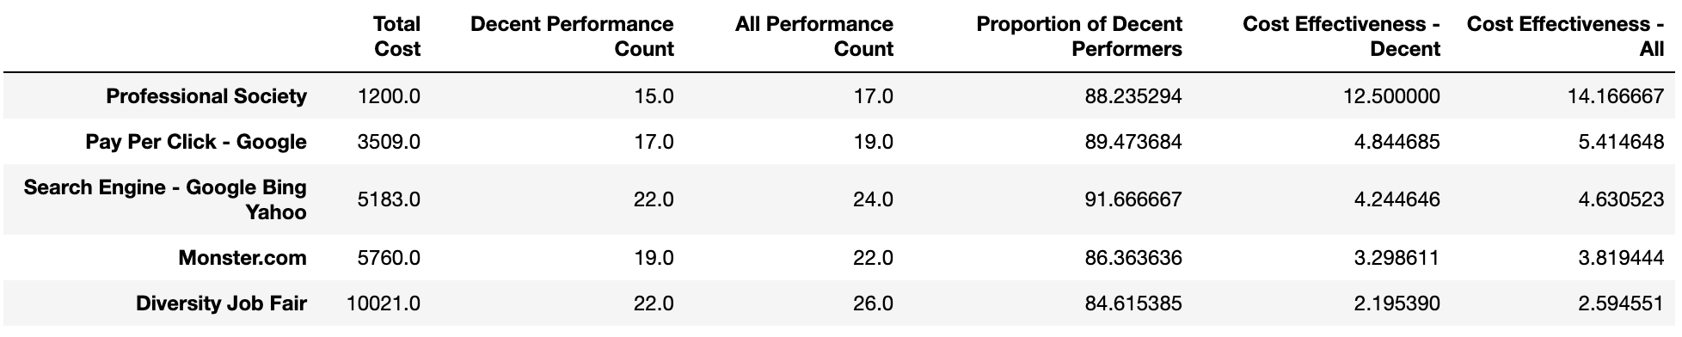
BEST “PAID” SOURCES
*Excludes employees who have “N/A- too early to review” & sources with less than 5
**Sorted based on descending order on “Cost Effectiveness – Decent”
This 3 recruitment sources yield the best with cost effectiveness on new hires with good performance. Also, a good proportion of the new hires had decent performance.

Slide 13
RECOMMENDATIONS
ABC Company should consider re-allocating its resources into Professional Society, search engines and pay per click as a recruitment source when looking for new employees. The company could consider focusing its recruitment costs into this 3 sources as the company do not seem to be rapidly expanding in 2017 and having a smaller pool of recruiting sources would be easier to manage.
HOW?
Professional Society
More job postings can be posted on professional society-maintained job boards. Expand our reach into more professional societies for more networking opportunities.
Pay Per Click / Search Engine
Increasing set budget for pay per click and increasing set number of keywords or phrases relevant to job openings.
Utilising SEO techniques to ensure job postings appear in relevant search results.
Notes:
Why not compare with how many employees are still employed?
As harsh as it may be, employees may leave despite having good performance. And therefore I feel that performance is a better indicator than the number of employees who have stayed

Slide 14
03
MANAGER PERFORMANCE
www.slidesgo.com
HR Analysis
-HUMAN RESOURCES DEVELOPMENT-
-HUMAN RESOURCES DEVELOPMENT-
Who is the best and lowest performing manager?

Slide 15


METRICS FOR MANAGERS
INDIVIDUAL PERFORMANCE | TEAM PERFORMANCE | TEAM RETENTION
Managers set the standard for performance within their teams. High individual performance from a manager serves as a role model for team members, demonstrating professionalism, and the standards expected within the company. | A good manager's effectiveness is often reflected in the collective output and achievements of their team. The overall team performance is a testament to the manager's leadership, coordination, and strategic planning skills. | A manager's ability to retain talent is often seen as a direct reflection of their leadership effectiveness. Retention can signal that a manager is successfully motivating their team, addressing their concerns, and providing a supportive environment.
20% | 40% | 40%
What?
What?
What?
$$\frac{Sum of all team member^{′}s performance}{Sum of maximum achievable score}$$
$$\frac{Manager individual performance}{Maximum achievable performance}$$
$$\frac{Current Team Member Count}{Total Team Member Count}$$
Why?
Why?
Why?
Weightage
Weightage
Weightage
Notes:
0 – Need improvement/PIP
1 - 90 day meets
2 – fully meets
3 – Exceeds
4 – Exceptional
Could be skewed with the metrics but I purposely did not ^2 to heavily penalize the score of employees, and the distribution of employees are mainly in the fully meets segment.

Slide 16
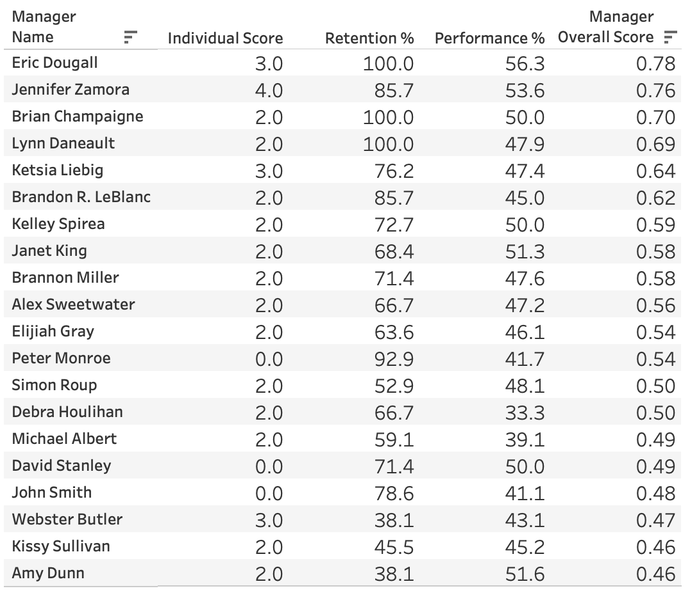
BEST PERFORMING MANAGER
Manager
$780.000
Eric Dougall
Expected revenue in 2024
Individual Performance
Exceeds
Retention
100%
Team Performance
BEST

Slide 17
LOW PERFORMING MANAGER
Manager
$780.000
Amy Dunn
Expected revenue in 2024
Individual Performance
Fully Meets
Retention
38.1%
Team Performance
51.6%

Slide 18
Analysis
Manager Amy Dunn manages one of the production teams in ABC company. Based on the metrics, her individual and team performance are decent, however when there is an issue when it comes to her team’s retention rate.
Originally, her team consisted of 21 members but has fallen to 8 members, a total of 13 team members have left. Based on this, she may have difficulties with managing a huge team as when she has a smaller team, her team’s performance has a decent score.
Recommendation
Conduct further team evaluations with the individual team members as well as Amy Dunn to find out more pain points.
Manager
Amy Dunn
Individual Performance
Fully Meets
HR Analysis
Retention
38.1%
Team Performance
51.6%

Slide 19
04
PAY RATE FACTORS
www.slidesgo.com
HR Analysis
-HUMAN RESOURCES DEVELOPMENT-
-HUMAN RESOURCES DEVELOPMENT-
Which factors drive pay rate the most?

Slide 20
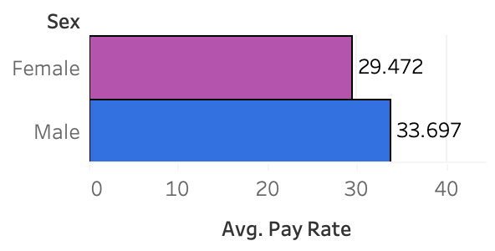
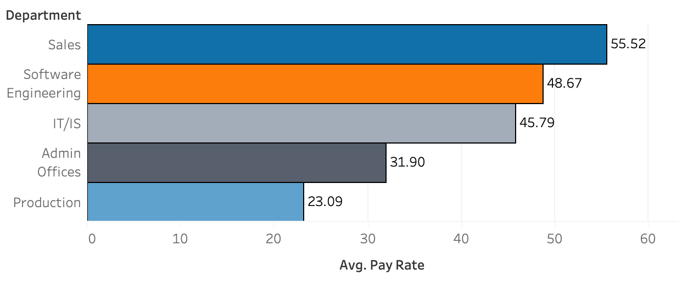
GENDER
DEPARTMENT
PAY RATE FACTORS
FOR EVERY
Based on the department, there is a vast difference in pay rate. This indicates that there is a good segregation in pay rate between positions and specialisations.
$1 Male earns,
Female earns $0.87
In Massachusetts, female employees earn 80.6% of their male counterparts. ABC Company has done better in terms of gender equality in pay.
Info: https://www.bls.gov/regions/northeast/news-release/2018/womensearnings_massachusetts_20181005.htm
Notes:
Also looked at correlation btw tenure / performance score but results showed that there were little to no correlations

Slide 21
05
EMPLOYEE RETENTION
www.slidesgo.com
HR Analysis
-HUMAN RESOURCES DEVELOPMENT-
-HUMAN RESOURCES DEVELOPMENT-
What are the characteristics and demography of employees that have a high probability of leaving the company in the next 3 months?

Slide 22
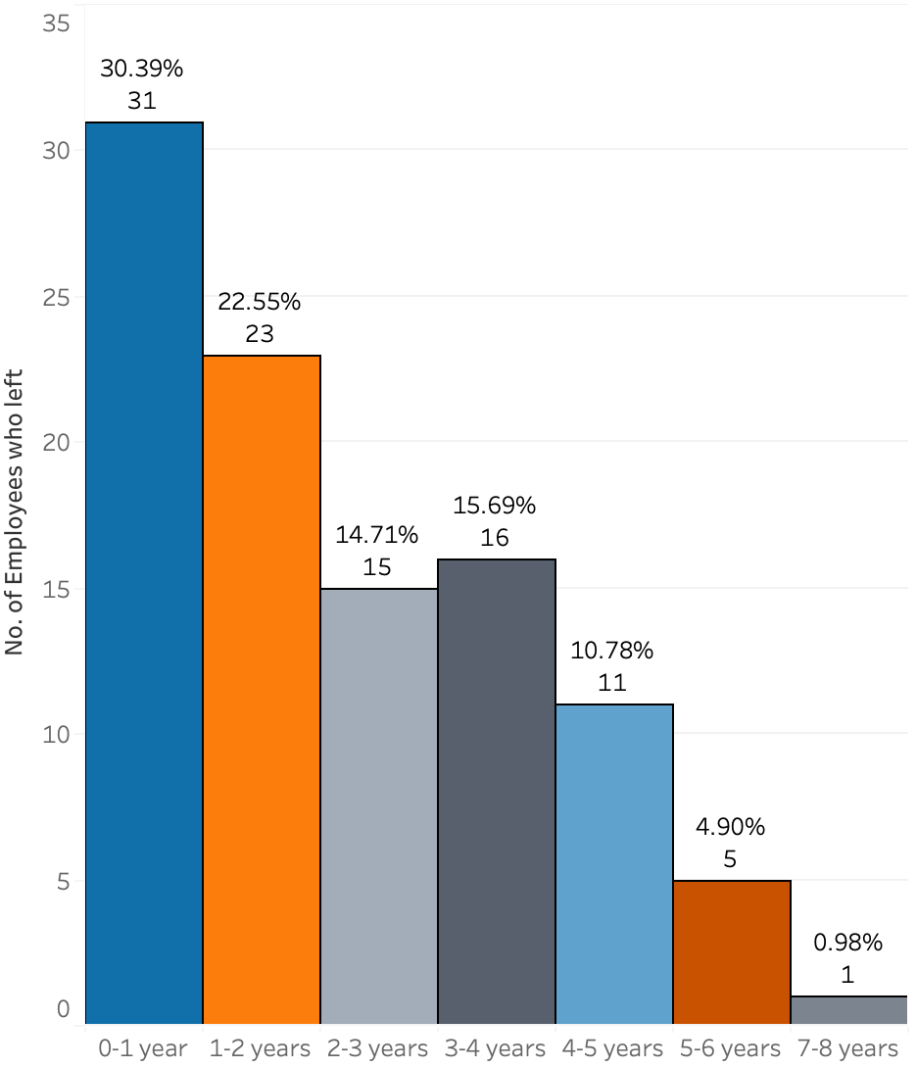
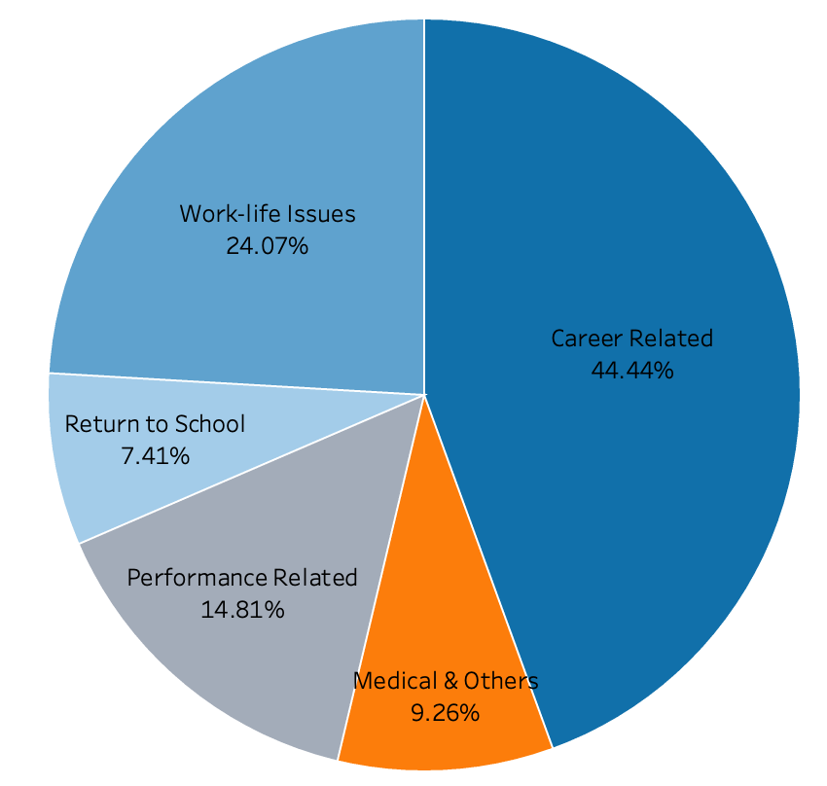
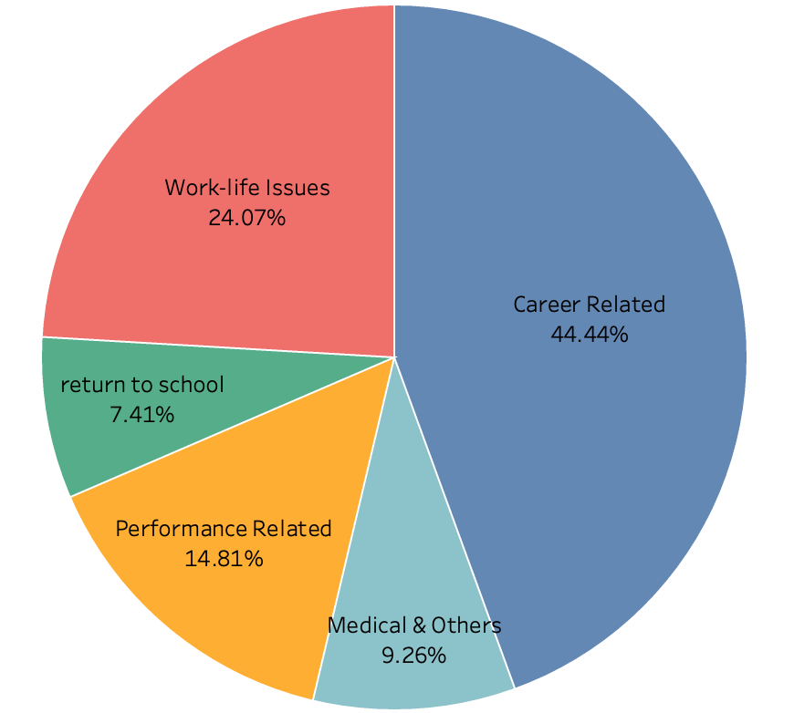
PAIN POINT
High number of employees with 0-2 years of tenure, consisting about 50% (54) of employees who have left the company. (Figure 6)
Referring to Figure 7, common factors on why employees leave are due to career related and work-life issues.
Figure 6
INSIGHTS
HR Analysis
1. Underlying issues with early employee turnover
2. Lack of work-life balance for employees
3. Job-role mismatch
4. Issues with onboarding
Figure 7
Employees who just started in the company have a high possibility to leave. More emphasis should be placed on employees who had just started.

Slide 23
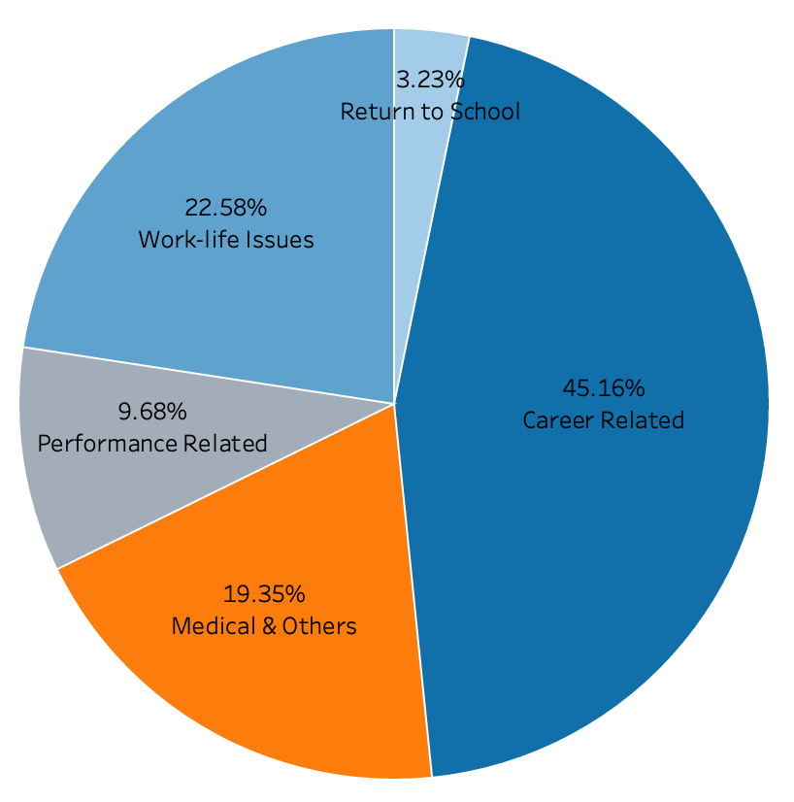
ANALYSIS
Figure 8
Figure 9
Figure 10
INSIGHTS
Similarly, employees commonly leave due to career related and work-life issues.
Within ABC Company, 50% of it’s employees have 2-4 years of tenure with the company. Though it does not face huge turnover as compared to their earlier counterparts, emphasis should also be placed in retaining them as they make up the core of the company.
1. Lack of career advancement / development opportunities
2. Lack of work-life balance for employees
1. Underlying issues with early employee turnover.
2. Lacking work-life balance for employees
3. Job-role mismatch
4. Issues with onboarding

Slide 24
RECOMMENDATIONS
Majority of employees who left in either tenure groups of 0-2 years and 2-4 years, terminated due to career related or work-related issues. Showing signs that current strategies used to develop and advance employees are lacking. Work-life benefits given to employees should also be revamped to improve retention within the company.
HOW?
Career Advancement / Development Opportunities
- Establishment of mentoring program, by pairing employees with experienced mentors can provide guidance, support and knowledge transfer.
- Development of succession planning, by identifying and preparing high-potential employees for future leadership roles ensures a talent pipeline within the company and gives employees clear advancement prospects.
Improved Work-life balance
- Providing the option of remote work, allowing employees to work from home.
- Wellness programs can be provided to employees, such as initiatives like gym memberships, fitness classes and health screenings.
Notes:
Why not compare with how many employees are still employed?
As harsh as it may be, employees may leave despite having good performance. And therefore I feel that performance is a better indicator than the number of employees who have stayed

Slide 25
06
DASHBOARD
www.slidesgo.com
HR Analysis
-HUMAN RESOURCES DEVELOPMENT-
-HUMAN RESOURCES DEVELOPMENT-
What are the characteristics and demography of employees that have a high probability of leaving the company in the next 3 months?

Slide 26
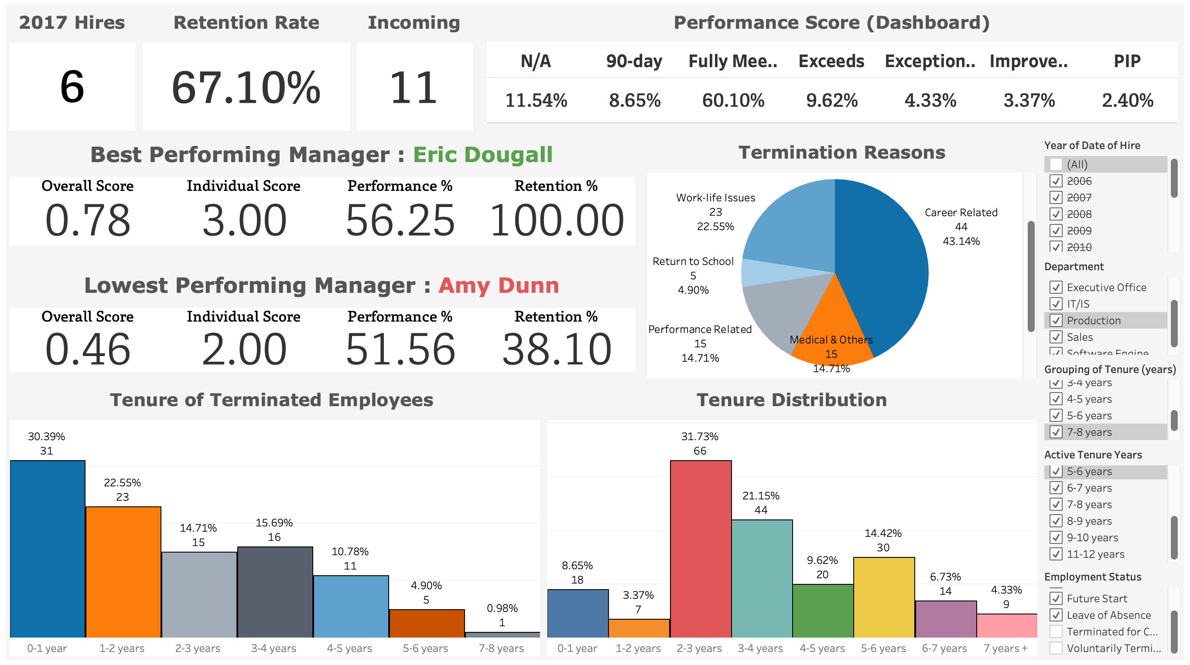
DASHBOARD
HR Analysis
Access this dashboard by clicking here!
https://public.tableau.com/views/HRAnalysisDashboard_17389406352520/Dashboard?:language=en-US&:sid=&:redirect=auth&:display_count=n&:origin=viz_share_link

Slide 27
Thank you!

